Slide 1
OMG!! I love Quiz Day
Yours truly,
Mr. Schlagel

Slide 2
#1
DNA stands for _________________
Dextrosenucleic Acid
Ribonucleic Acid
Deoxyribonucleic Acid
Double Nucleic Acid

Slide 3
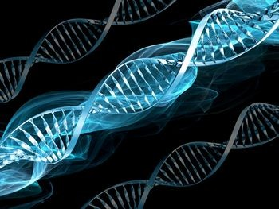
#2
What is the shape of DNA? Or what does it look like?

Slide 4
#3
There are 3 things that make up a Nucleotide! Which of these 3 things make up a NUCLEOTIDE?
Phosphate, Backbone, Sugar, Base, Ladder, Carbohydrate, Fats, Oxygen, Hydrogen…

Slide 5
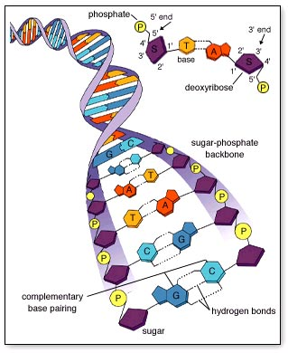
#4
There are a total of 5 nitrogen bases! Five you say… We have only learned 4 up to this point!
List the names of the 4 Nitrogen bases we have learned so far

Slide 6
#5
The bases always pair a specific way!
Adenine always pairs with _____________
Cytosine always pairs with ______________

Slide 7
#6
Bases that are Purines have _____ rings (1 or 2)
Bases that are Pyrimidine's have ____ rings (1 or 2)

Slide 8
#7
The backbone of DNA is similar to the sides of a ladder! Not your backbone!
Which 2 things make up the backbone of DNA?
Base and phosphate
Phosphate and base
Sugar and base
Sugar and Phosphate

Slide 9
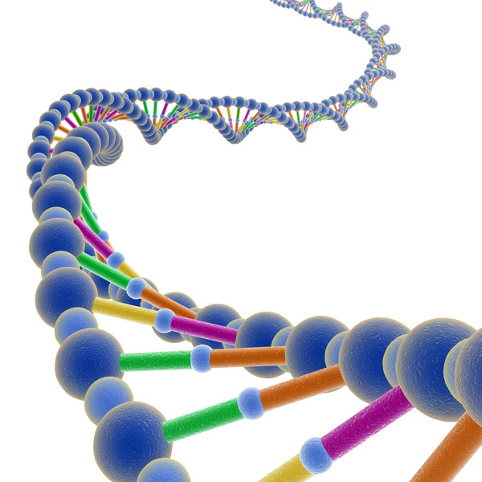
#8
What type of bond holds together the bases in the middle of the ladder?
Covalent Bond
Ionic Bond
Hydrogen Bond
James Bond

Slide 10
#9
2 Men were credited with discovering the double helix shape of DNA!
Who was one of those people? Any part of the name will work!

Slide 11
#10
Science is so _________ !
Stupid
Dope
Boring
Awesome
Eh….its like kinda cool bro, but then it’s like, I feel so dumb when Mr. Schlagel talks because he is so smart and its just like, I want to be him sometimes!

